Slide 1
CS440/520 Artificial Intelligence
Computer Science Department
Lecture 5:
Review of Adversarial Search – Local Search
16 September 2014
Instructor: Kostas Bekris

Slide 2
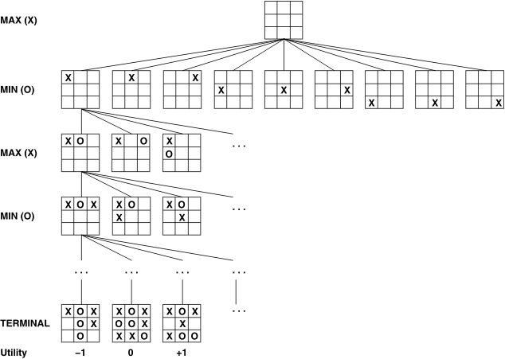
Tic-Tac-Toe

Slide 3
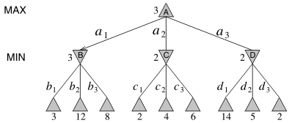
Minimax Algorithm

Slide 4
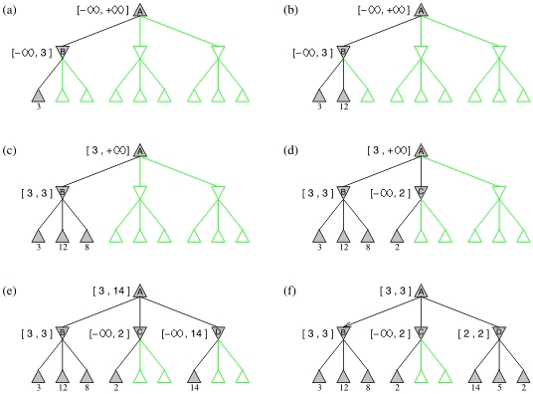
α-β (alpha-beta) pruning

Slide 5
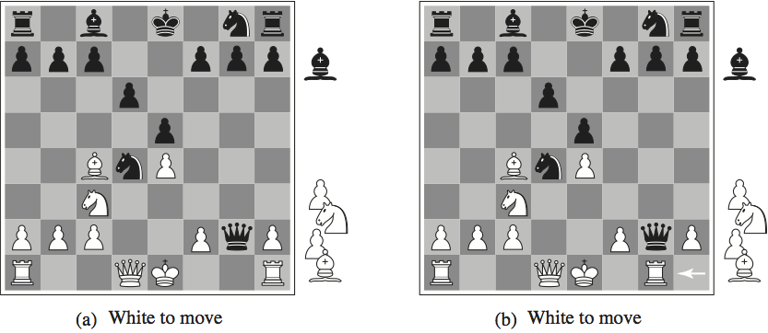
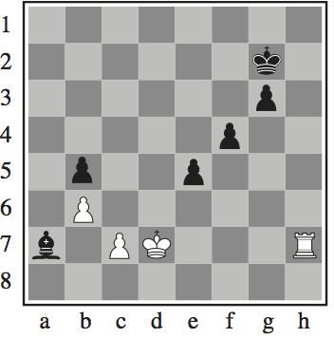
Chess

Slide 6
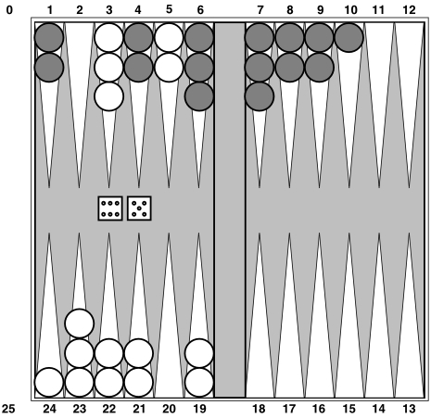
Backgammon

Slide 7
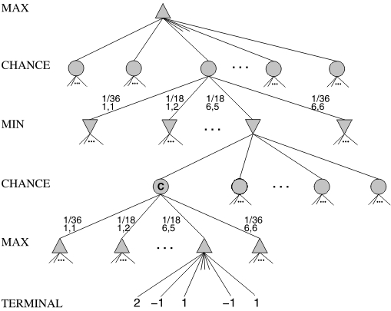
Chance in Games

Slide 8
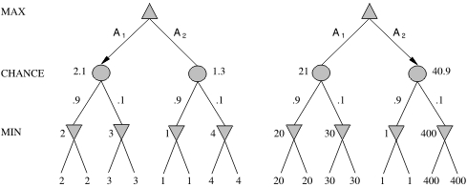
Scaling Issues

Slide 9
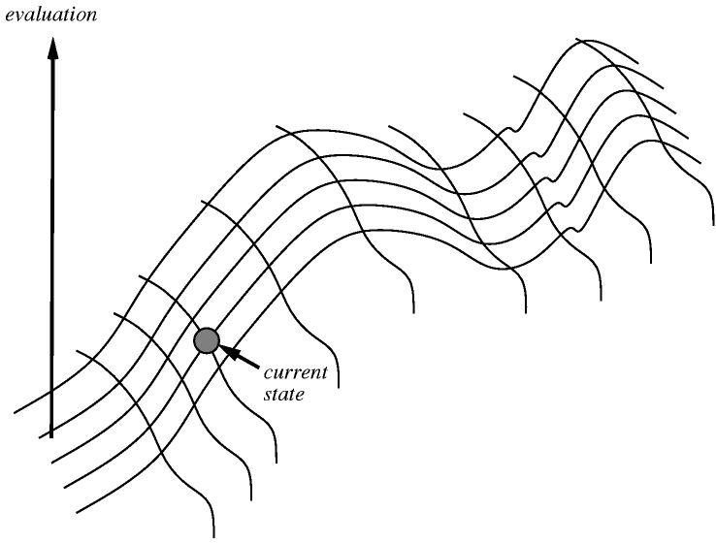
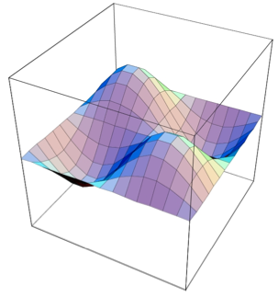
Hill Climbing

Slide 10
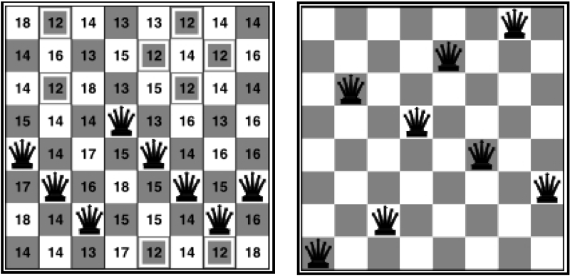
8-queens Example

Slide 11
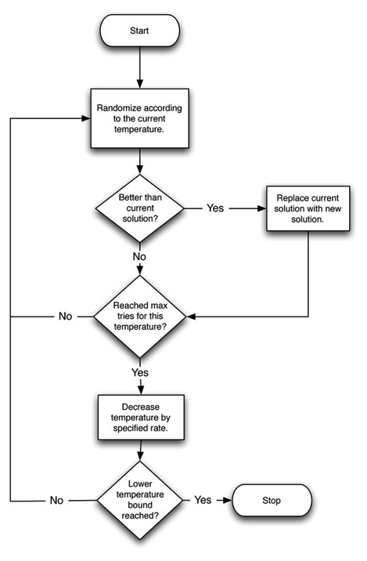
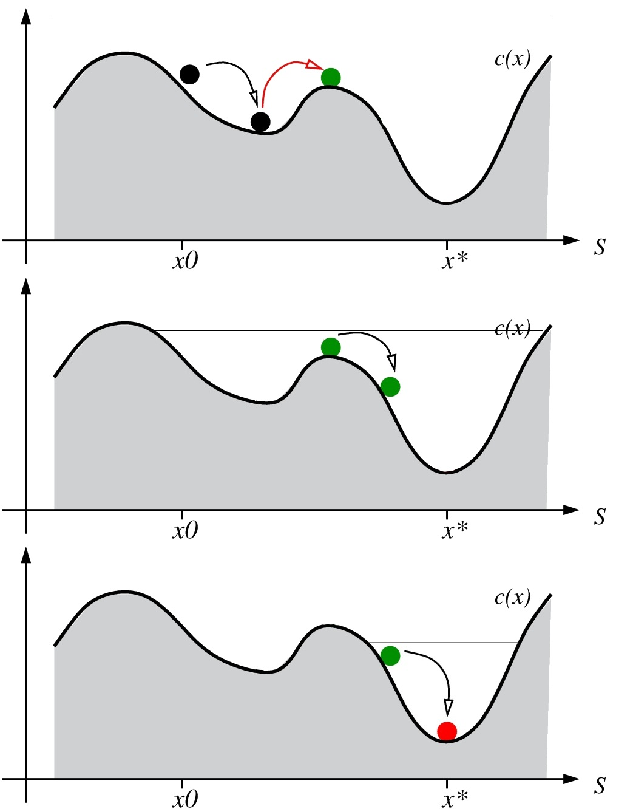
Simulated Annealing

Slide 12
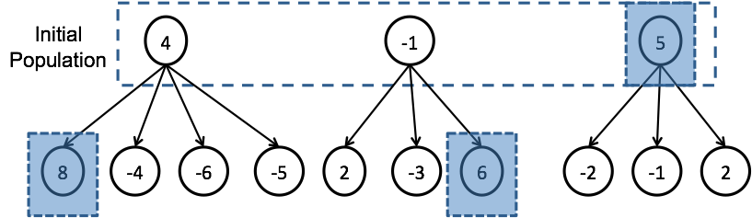
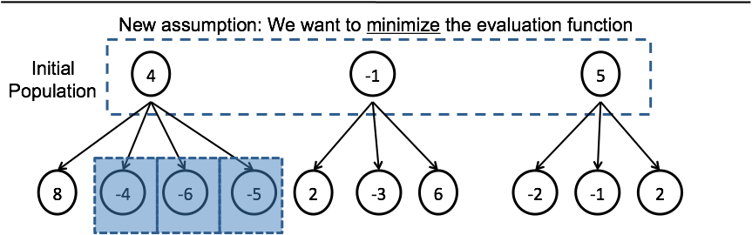
Local Beam Search

Slide 13
Genetic Algorithms

